Slide 1

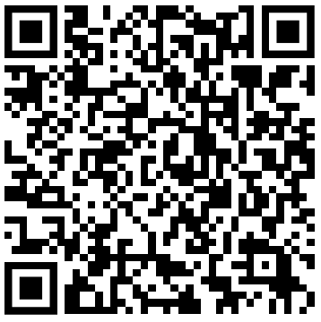
Image Segmentation
& Object Detection
https://forms.gle/YG9TtSbimF2bhiUR8
Attendance
Code inside the form
Some participants are allocated to Zoom due to limited capacity, first-come basis and LEARNOVA priority

Slide 2
Content
What is Image Segmentation?
Details
Examples
How about Object Detection?
Details
Examples
How they actually work
RNN/CNN Basics
Image Segmentation Libraries
SAM (Segment Anything Model)
Object Detection Libraries
YOLO (You Only Look Once)

Slide 3
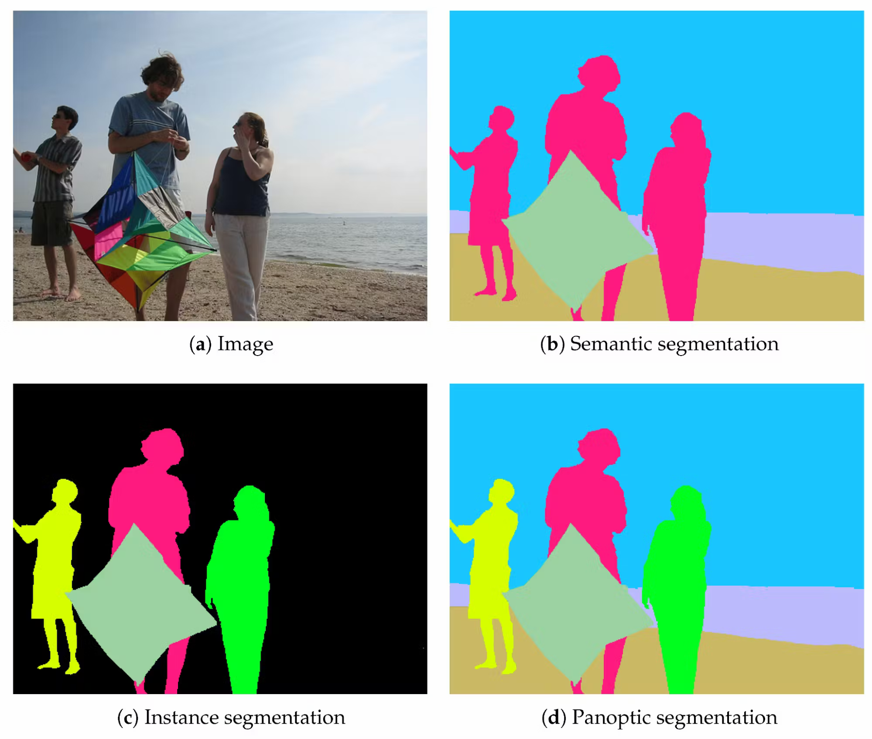
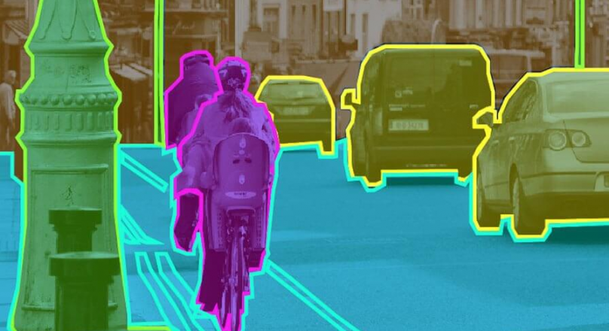
What is Image Segmentation?
Segmentation is the process of partitioning an image or video into meaningful regions to identify and differentiate objects or regions of interest.
Partitioning an street into distinct areas
Different types of Segmentation

Slide 4
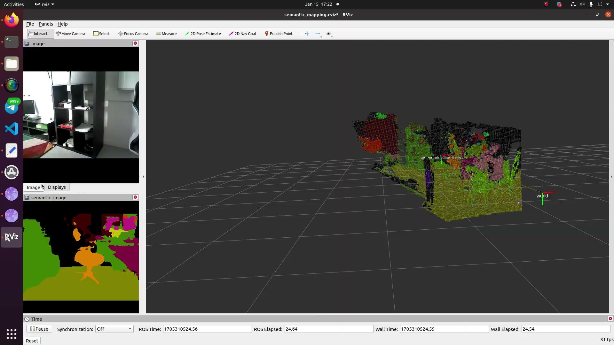
Real world example of Image Segmentation (my current robotics URECA project). Try to notice the different regions (both 3D and 2D!) and how they relate to the actual image in the top left corner.

Slide 5
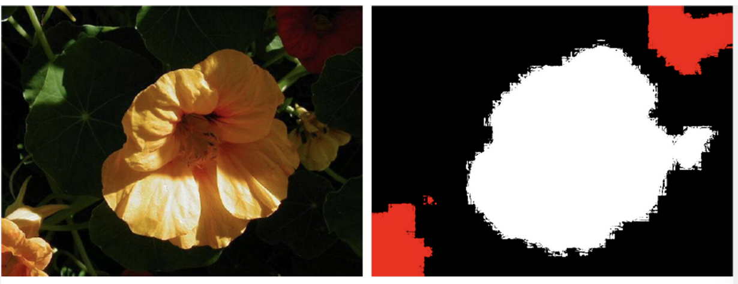
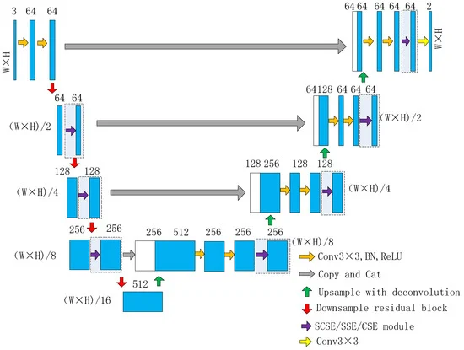
Image Segmentation Theory!
One commonly used architecture is called U-Net (due to its characteristic shape). The starting image is downsampled (contracted) towards the “bottom” of the U-Net, and then it gets “expanded” during upsampling, resulting in a final output of pixels within a region
Original Image
Output Image
Intermediate Image

Slide 6
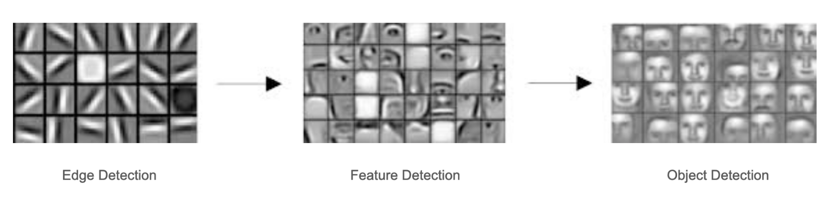
Image Segmentation Theory!
One commonly used architecture is called U-Net (due to its characteristic shape). The starting image is downsampled (contracted) towards the “bottom” of the U-Net, and then it gets “expanded” during upsampling, resulting in a final output of pixels within a region
Original Image
Output Image
Intermediate Image
This section is simple a classic CNN!

Slide 7
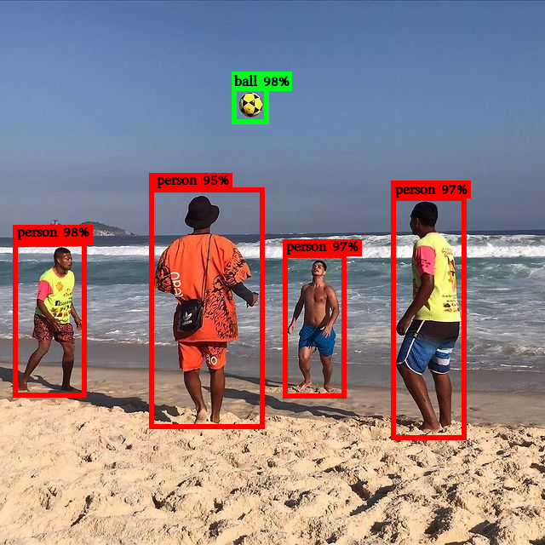
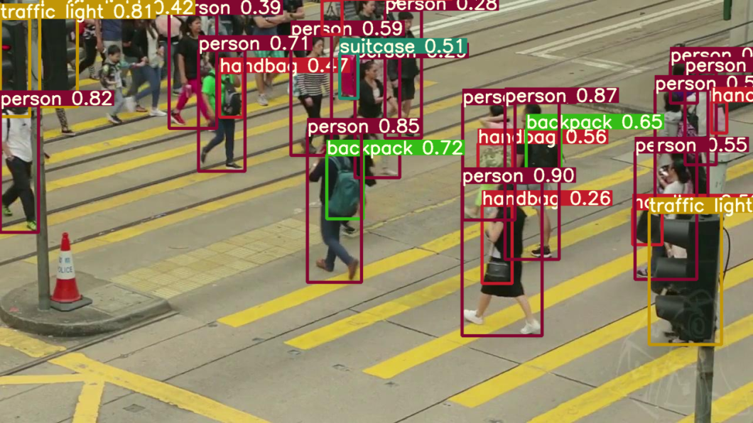
How about Object Detection?
Object detection involves localizing and classifying objects within an image or video. It aims to identify specific objects of interest and provide their bounding boxes, crucial for tasks like object tracking and scene understanding.
Determining coordinates of a ball in an image
Detecting pedestrians crossing a busy intersection

Slide 8

Real world example of Object Detection (also my current URECA project)! The main focus is on the bounding boxes and labels. Extra: the green dots (pointclouds) are for the 3D stuff yall saw in the previous slides.

Slide 9
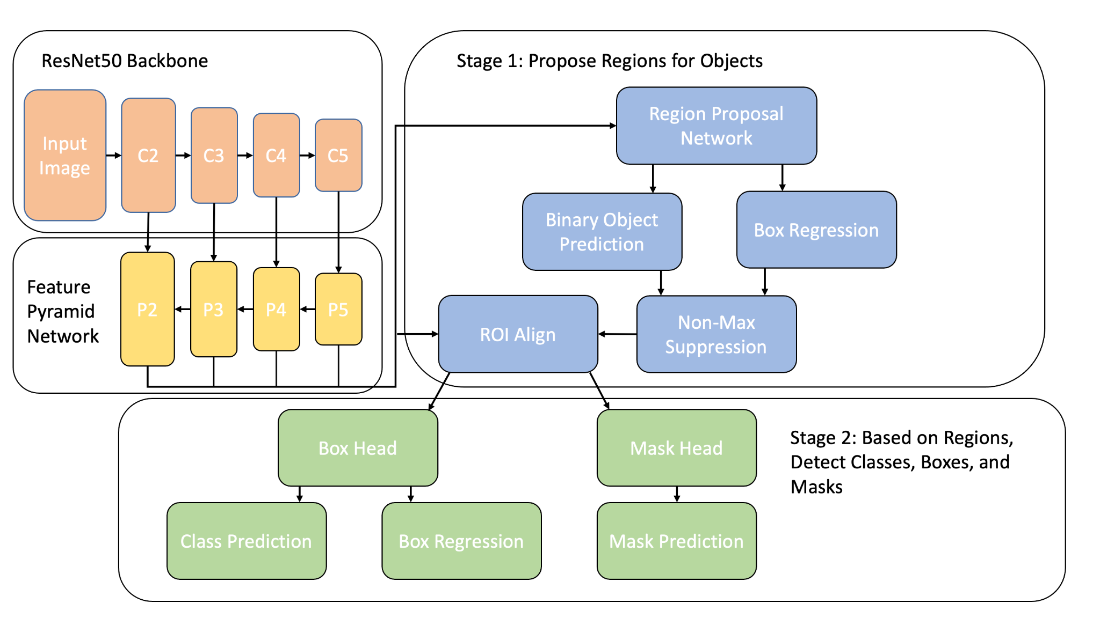
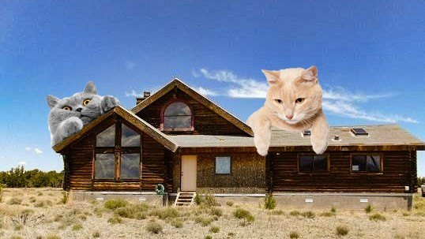
Object Detection Theory!
For Object Detection, a commonly used architecture is the Region-based Convolutional Neural Network (RCNN) (*not to be confused with RNN, Recursive Neural Networks). One can think of the main problem as
One can think of the main challenge in object detection as “How do detect objects in multiple regions of the image?”
Output:
42% house
58% cat
(mUcH cOnFuSe!)
Simple computer vision
Output:
Rect 1: cat
Rect 2: cat
Rect 3: house
(along with the x,y,w,h coordinates of the rects)
Object Detection

Slide 10
Object Detection Theory!
For Object Detection, a commonly used architecture is the Region-based Convolutional Neural Network (RCNN) (*not to be confused with RNN, Recursive Neural Networks). One can think of the main problem as
One can think of the main challenge in object detection as “How do detect objects in multiple regions of the image?”
Output:
42% house
58% cat
(mUcH cOnFuSe!)
Simple computer vision
Output:
Rect 1: cat
Rect 2: cat
Rect 3: house
(along with the x,y,w,h coordinates of the rects)
Object Detection
This section is simple a classic CNN!

Slide 11
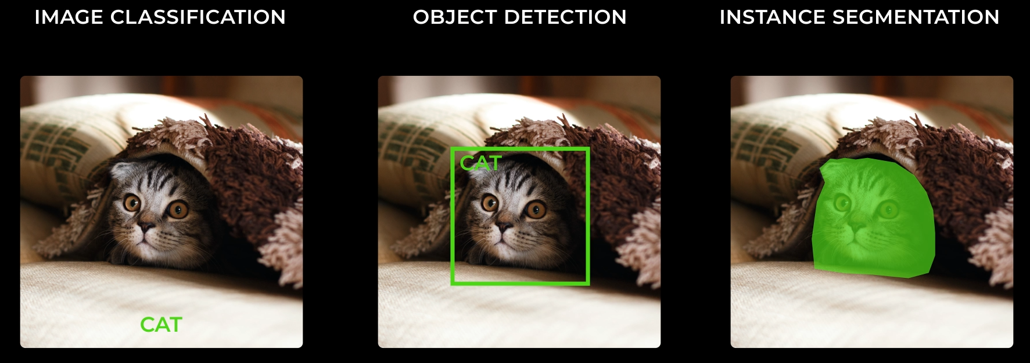
In summary / To put it simply / Kurzgesagt,
Number of labels: 1
(Prob_cat)
Number of labels: 5
(Prob_cat, W, H, X, Y)
Number of labels: 100-1000
(X-Y coordinates of each vertex of the bounding polygon)

Slide 12
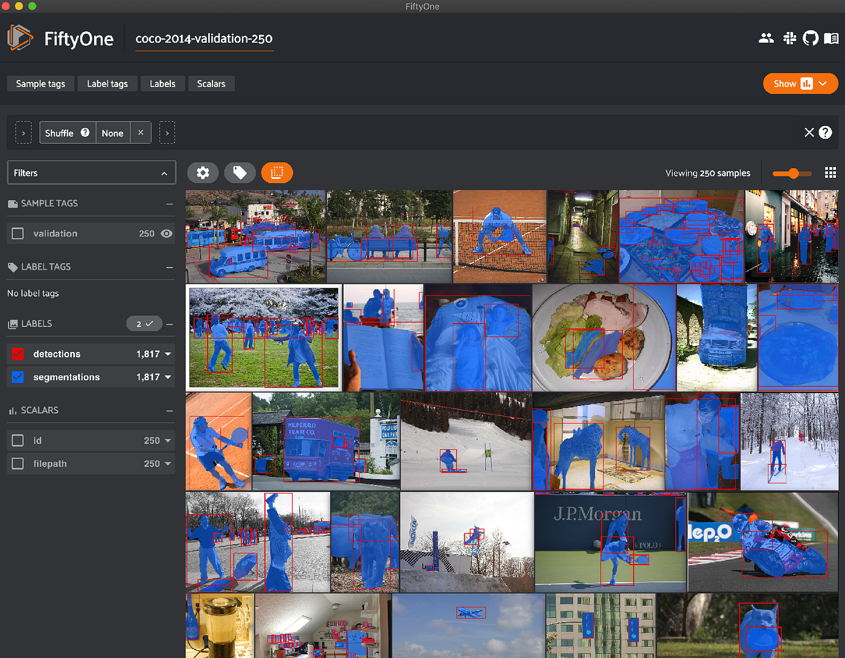
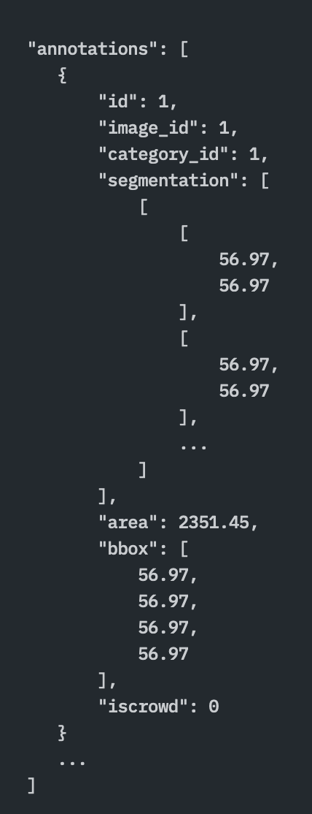
So how does the training data look like?
Labels stored in JSON format:
(For detection)
- Category of object
- X, Y of bounding box
- W, H of bounding box
(For segmentation)
- List of [X, Y] coordinates
Modern training data has to be optimised for multiple use cases! (Example above is COCO dataset)

Slide 13
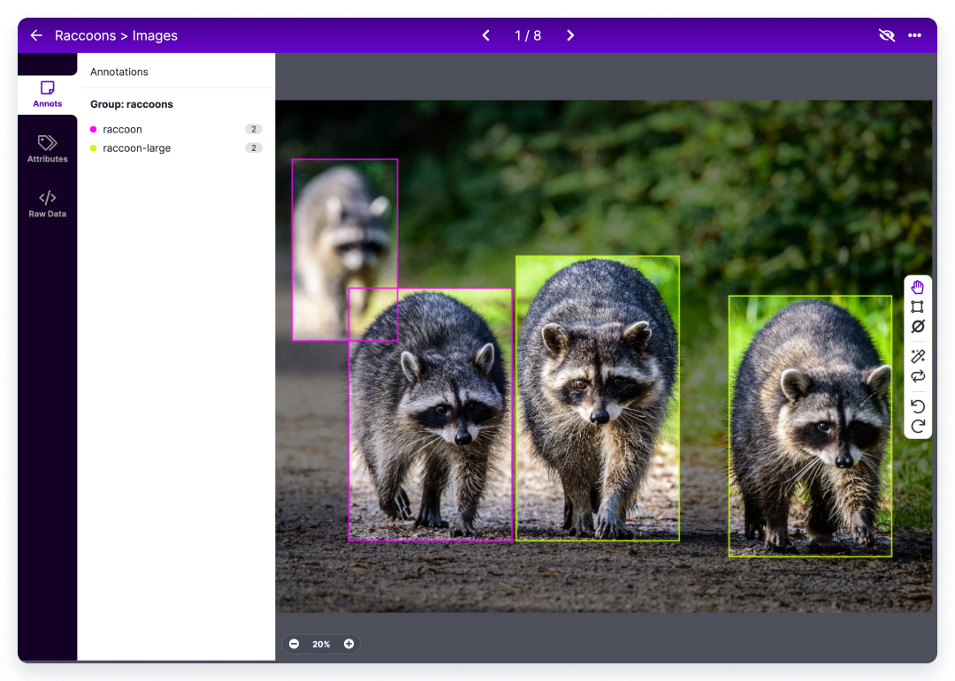
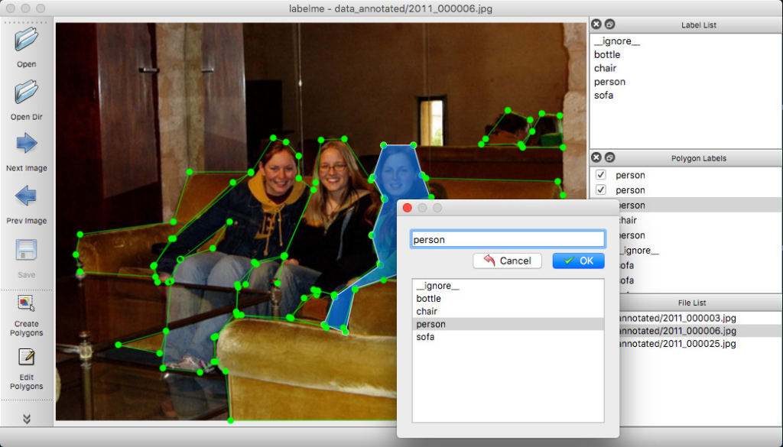
And how is training data created?
Roboflow, a popular website that allows one to create bounding boxes for object detection
Labelme, an app that allows one to create polygons for image segmentation
Someone (prolly an unpaid intern) has to manually label the data!!! (Quiz: supervised or unsupervised learning?)

Slide 14
POP QUIZ!

Slide 15
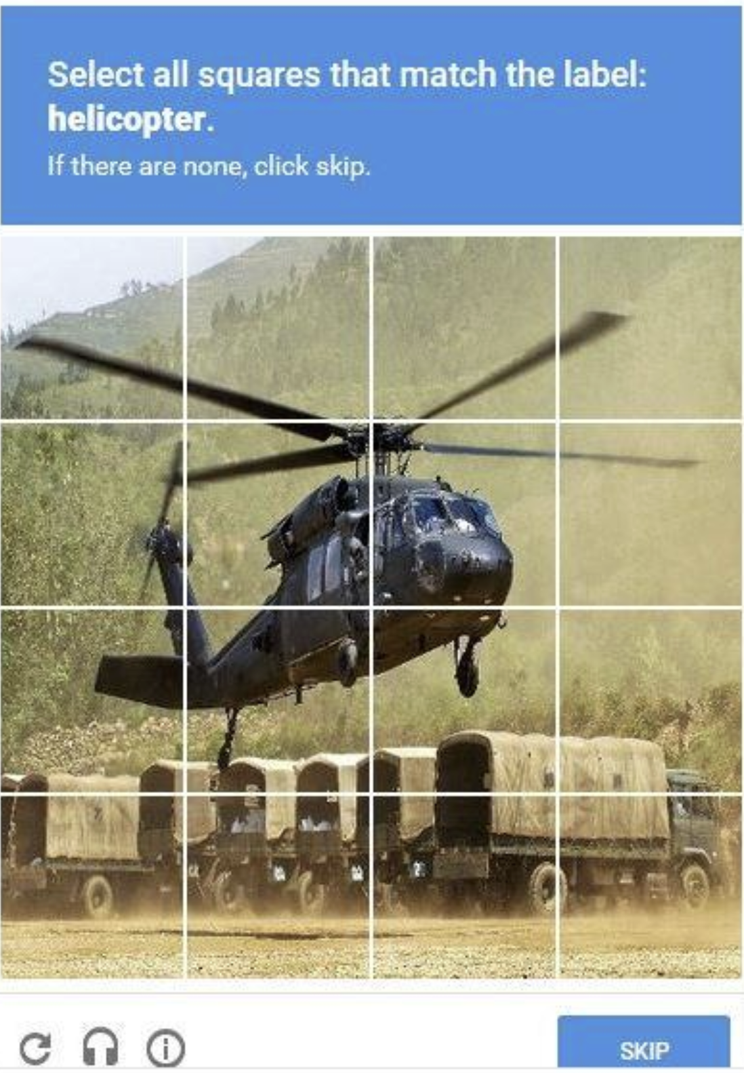

POP QUIZ!
Is the famous Google CAPTCHA considered to be:
Image Detection
Image Segmentation
Object Detection
Object Segmentation

Slide 16

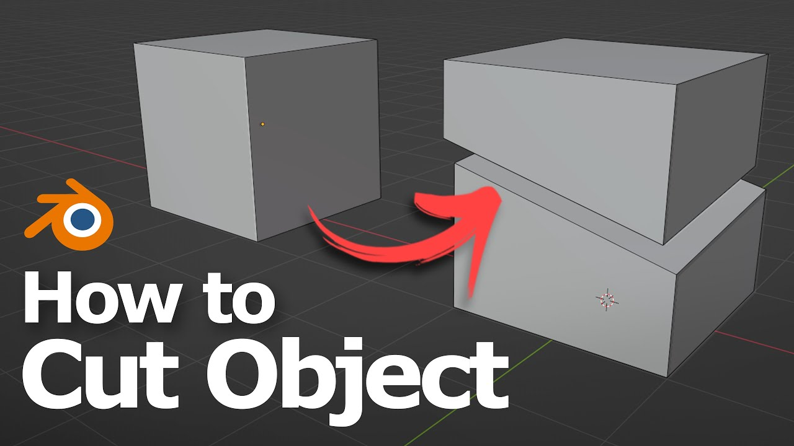
POP QUIZ!
Is the famous Google CAPTCHA considered to be:
Image Detection
Image Segmentation
Object Detection
Object Segmentation

Slide 17
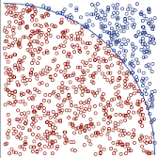
POP QUIZ!
Is the famous Google CAPTCHA considered to be:
Image Detection
Image Segmentation
Detecting the tiles that has a helicopter present
Too many pixels to label :(
Object Detection
Object Segmentation

Slide 18
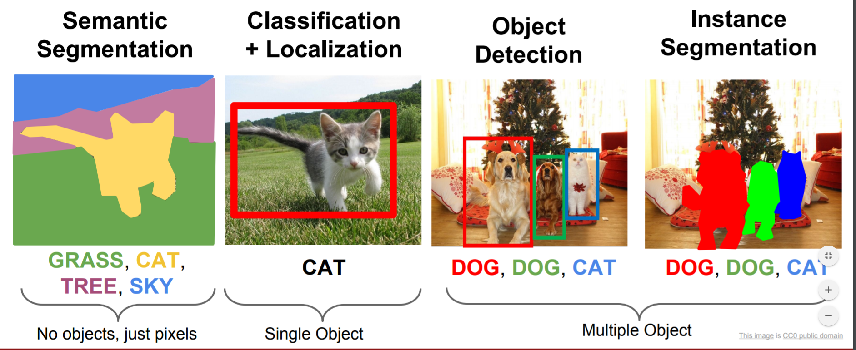
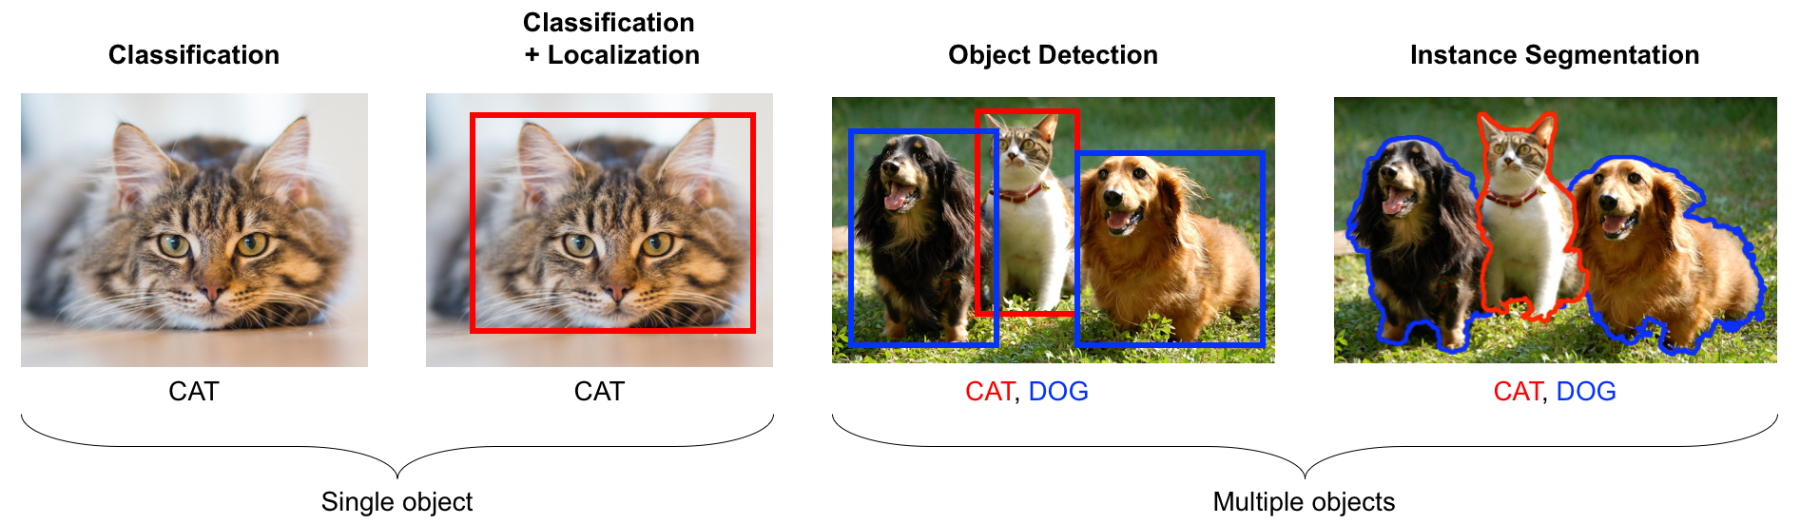
Most models today use a combination of both!
Depending on the application that you intend to create, sometimes object detection is more suitable, while other times image segmentation may be more useful!
Both U-Net (image segmentation) and R-CNN (object detection) are considered old technology (both came out around 6-7 years ago), but they serve as the foundation for most modern frameworks today!

Slide 19
Machine Learning Libraries
Let’s face it… we are not ML researchers. But that doesn’t mean we cannot “stand on the shoulder of giants”
YOLO v8 by Ultralytics
Demo: https://yolov8.com/
Segment Anything Model (SAM) by Facebook Meta:
Demo: https://segment-anything.com/

Slide 20
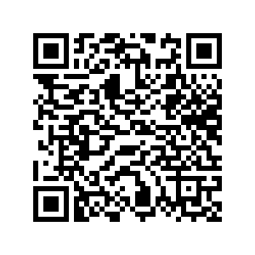
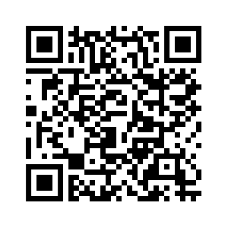
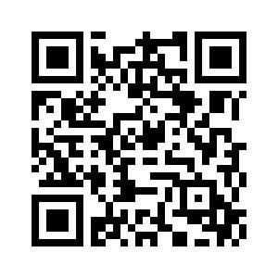
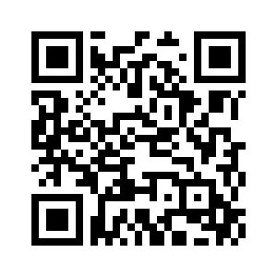
Segmentation & Detection QR Codes
MLDA Handbook
https://docs.google.com/spreadsheets/d/1xPrLgY6E_iNN2R0jU0MEf8N75Xcn5FIM--ruNihjrqU/edit#gid=1925502567
LEARNOVA Playlist
https://www.youtube.com/playlist?list=PLXpIV63PRtvXM5I-6Fv9Z1s3tXV91n636
Quiz
https://forms.gle/GuoFo67PnsTEJNPv8
Feedback https://forms.gle/ee8EGutQaYjTmiwSA

